Slide 1
CS 252 Database Management Systems
Jan – May 2020
IV Semester
* Use the slides for reference only. Refer the text book for details

Slide 2
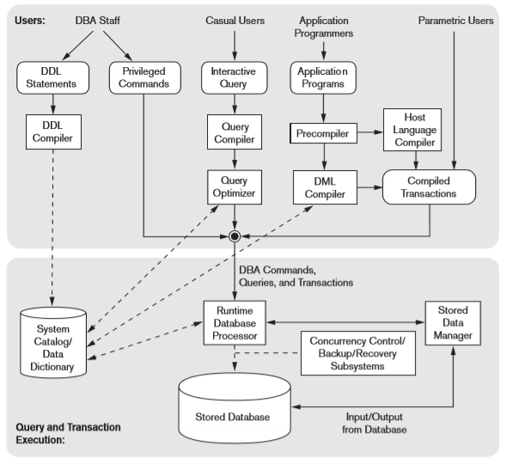
DBMS Component Modules

Slide 3
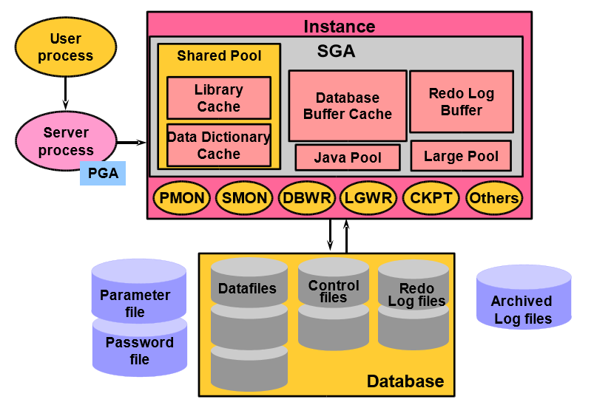
Oracle components

Slide 4
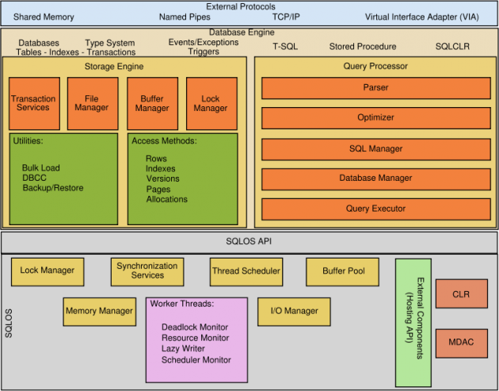
SQL Server components

Slide 5
Database utilities
Data loading
Performance monitoring
Backup/restore
Storage configuration

Slide 6
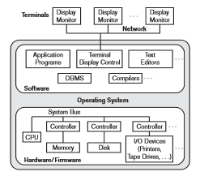
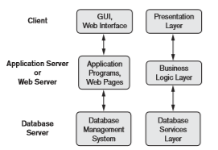

Database architectures
Centralized DBMS
2 Tier Client-Server DBMS
3 Tier Client-Server DBMS

Slide 7
Classification of DBMSs
Based on the data model used
Legacy: Network, Hierarchical.
Currently Used: Relational, Object-oriented, Object-relational
Recent Technologies: Key-value storage systems, NOSQL systems: document based, column-based, graph-based and key-value based. Native XML DBMSs.
Other classifications
Single-user (typically used with personal computers) vs. multi-user (most DBMSs).
Centralized (uses a single computer with one database) vs. distributed (multiple computers, multiple DBs)

